Slide 1
Value Stream
All of the activities required to transform a requirement into a delivered product
(Activities do not necessarily add value)
Percent Complete and Accurate – Value Stream metric
https://www.youtube.com/watch?v=5YJYMLaV9Uw

Slide 2
Steps to decide on Kanban columns
A value stream map is a living map that uses symbols and arrows to visualize the flow of materials and information through the organization. It visualizes active and inactive times, handoffs, and more.
There are two common approaches:
Lean measures and minimizes the time spent between columns (minimize waste)
Kanban measure the time spent in the column (optimize flow)
Kanban is a pull system. Columns pull from the left.
Therefore there must be a “done” column for each process column, which the column to the right can pull from
Senior management of the project should be involved in the column selection

Slide 3
Identify predictable series of steps to transform a requirement to a delivered product.
Things that take less than a day should probably not get a column, but should be included in another column
e.g. Requirements, BDD specs, development, Code review, QA, release management, deploy
Identify the inputs that feed into those processes. If there are too many inputs, that is a red flag
Meet with Dev and Ops to review that chart, to see the world through the same lens
Goals
What’s our average lead time; how can we improve it
Identify where work gets stuck in the process
Identify remediation strategies – Remove constraints, hire people, re-appropriate resources
https://leankit.com/blog/2017/08/value-stream-mapping-for-software-development/

Slide 4
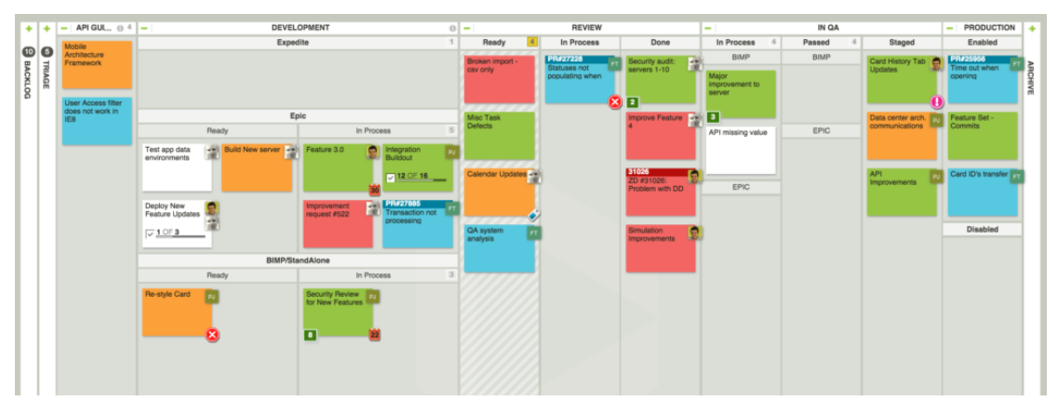
https://leankit.com/learn/kanban/kanban-board-examples-for-development-and-operations/

Slide 5
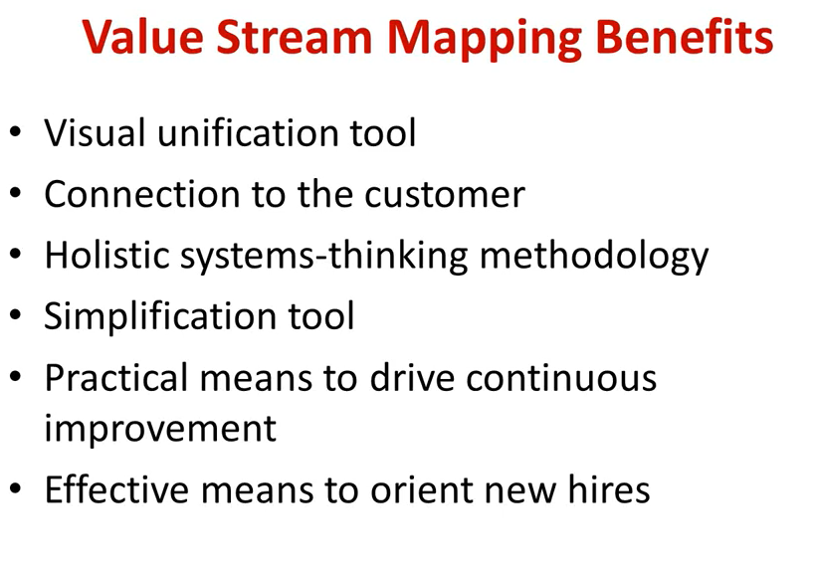

Slide 6
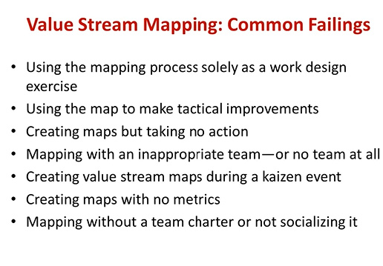

Slide 7
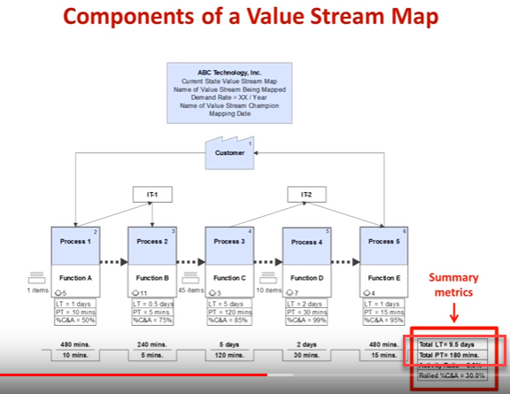

Slide 8
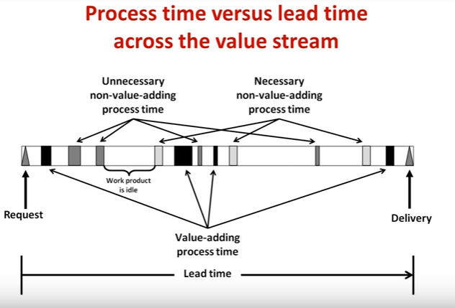
Muda: Unnecessary Non-value adding process time

Slide 9
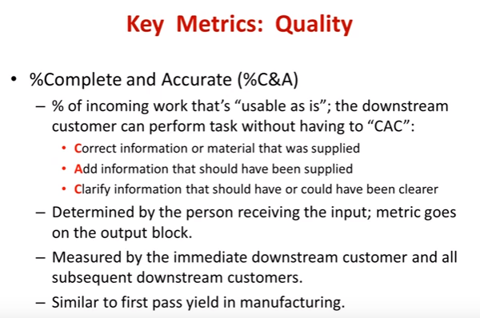

Slide 10
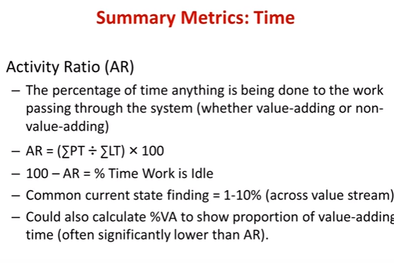

Slide 11
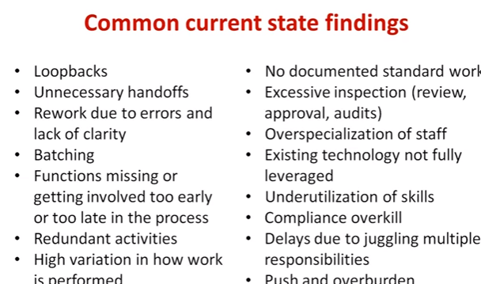

Slide 12
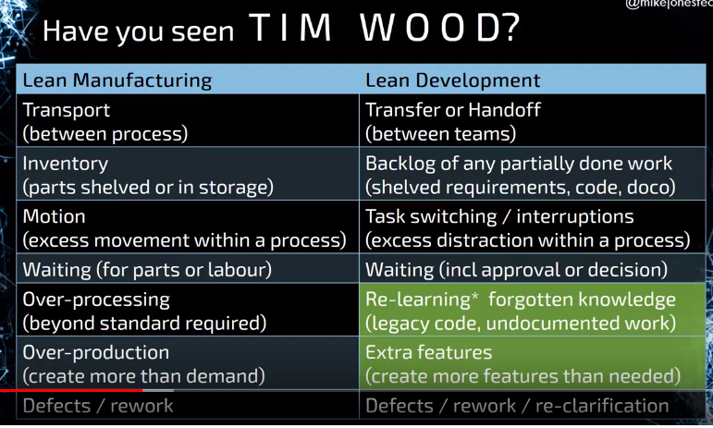
The trick to value stream mapping is to recognize the bottlenecks and eliminate the waste
Lean vs Kanban

